Slide 1
Energy Demand Research Champions Launch Webinar
11 October 2022
Dr Mari Martiskainen
Theme lead in Equity & Justice, CREDS
Co-Director, Sussex Energy Group
Professor Sara Walker
Director, National Centre for Energy Systems Integration

Slide 2

The energy demand dilemma
British energy security strategy (Apr 2022):
‘We will continue to need gas to heat our homes and oil to fill up our tanks for many years to come’ (p.4)
‘Electricity demand is highly likely to double by 2050’ (p.12)
Climate Change Committee: Progress in reducing emissions (Jun 2022):
‘Current programmes will not deliver Net Zero’ (p.n/a)
‘Major failures in delivery programmes towards the achievement of the UK’s climate goals’ (p.n/a)
Notes:
British energy security strategy: Our homes are our castles – people want choices regarding how they improve them…this is not being imposed on people and is a gradual transition following the grain of behaviour. The British people are no-nonsense pragmatists who can make decisions based on the information (p.6)
CCC: There is a shocking gap in policy for better insulated homes (p.n/a)

Slide 3
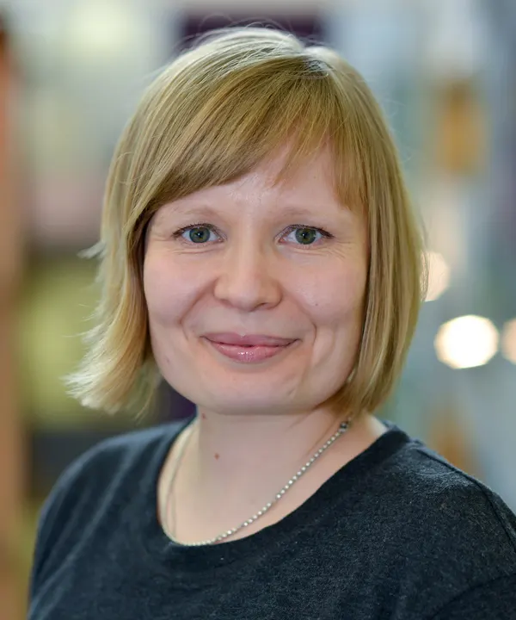

Energy Demand Research Champions
Leadership
Interdisciplinary
Career stages
Geographical spread
EDI
Familiar with and new to CREDS
PI: Centre management, Centre ambassador, Research excellence lead, EDI lead
Co-I: Overall strategy, Centre impact lead, Centre ECR lead
Notes:
Highly experienced in energy demand and energy systems research leaders
Interdisciplinary backgrounds – social & technical
Complementary career stages
Contributions to leading research
Commitment to EDI (also all female team)
MM in CREDS, SW outside of CREDS
Geographical spread
History of collaboration

Slide 4

Our vision
To develop an interdisciplinary, inclusive and diverse Centre which undertakes methodologically rigorous research that can be applied at speed and scale for significant impact
Long-term, make energy demand reduction the foundation for a fair transition to Net Zero
Notes:
How can we show speed and scale and how embedded

Slide 5

Our main objectives
Develop an inclusive, interdisciplinary and cross-sectoral Centre
Deliver robust and reflexive research
Promote energy demand reduction as equal to supply-side
Articulate wider benefits of energy demand reduction
Integrate equality, diversity and inclusion in research process
Engage and network widely
Build collaborative, open and supportive teams
Notes:
1. To develop an inclusive, interdisciplinary and cross-sectoral Centre that advances knowledge and uptake of energy demand reduction solutions
2. To develop a robust and reflexive research programme with the capacity to cope with, and respond to, rapidly changing social, environmental, political and economic dynamics and unexpected events
3. To identify and prioritise mechanisms that promote energy demand reduction technologies and strategies, so that they have equal political and societal enthusiasm as supply-side solutions
4. To clearly articulate the wider benefits of energy demand reduction, moving beyond climate action to benefits fundamental in addressing growing income inequality and the cost-of-living crisis
5. To integrate equality, diversity and inclusion (EDI) across the entire research process to secure best outcomes for staff and the energy demand research field
6. To engage and network widely with a diverse range of stakeholders and research beneficiaries for meaningful and significant impact
7. As Co-champions, be leaders that build collaborative, open and supportive teams.

Slide 6
8-month action plan
Notes:
WP1: Consultation
Webinars on our process
Internal consultation with CREDS
External consultation with stakeholders and beneficiaries
WP2: Co-development
Identify research themes via deliberative workshops
Reflective practice with UKRI, CREDS Advisory Board
WP3: Consortium building
Open call: based on leadership skills, research questions, engagement, impact and EDI
Development of full Centre proposal
Finalise and set up CREDS2

Slide 7
Consultation: Listen to the community and stakeholders
Internal consultation with CREDS members during September-October
Feedback from CREDS Mid-Term Review
Meetings with CREDS Core Team, Theme Leads and consortium members
What’s working well, what could be improved, future objectives
Confidential meetings
Launch Webinar 11th October
Survey of key stakeholders (academics, policy, industry, NGOs, etc.) during October
Notes:
Plans for community and stakeholder engagement in developing the Centre. Does this include plans for engagement with the Energy SAC?

Slide 8
Co-development: Further stakeholder engagement
Deliberative online workshops with key stakeholders in November
Building on outcomes from internal interviews and survey
Feeding into the development of research themes/challenges
Facilitated by experts using World Café and Storytelling techniques
Reflexive practice on research programme development

Slide 9
Consortium building: Develop full Centre proposal
November: Open call for Co-I’s based on leadership skills, research questions, engagement, impact and EDI
December – February: Development of full Centre proposal
28 February 2023: Deadline for final proposal
Funding: £15 million over 5 years

Slide 10

Centre design
Research themes
Cross-cutting activities
Building on CREDS key findings
Leadership
Notes:
A number of interdisciplinary research themes (e.g. equity, efficiency, mobility, flexibility, governance)
Centre cross-cutting activities (e.g. responsive fund, events, training, tool kits etc.)
Building impact from previous research, while identifying new questions
PI: Management & Co-I: Strategy
Theme leads as collaborative leaders
Keep some institutional history with CREDS (e.g. branding, website, core team activity)Themes designed through engagement in WP1 and WP2
Cross-cutting leads to interdisciplinary research
Co-creation will show areas for new research development
Ongoing research activity, e.g. research development, publications, dissemination and engagement activities, knowledge exchange.
We also expect the Centre to host regular workshops, webinars and events, to receive feedback on initial project plans, disseminate findings, and provide training

Slide 11
Key dates
Date | Action
September to October 2022 | Internal consultation
11 October 2022 | Launch webinar
mid-October to early-November 2022 | Stakeholder survey
7 to 9 November 2022 | Stakeholder workshops
mid-November to December 2022 | Open call for Co-I's
December 2022 to February 2023 | Full proposal writing
28 February 2023 | Call deadline

Slide 12

International Energy Agency (IEA), found that 'doubling the rate of energy efficiency improvements seen in the last decade would, by 2030, slash global energy use by the same amount used in China every year, saving households $650bn' Energy Demand Reduction is a global imperative
Thank you!
Dr Mari Martiskainen
m.martiskainen@sussex.ac.uk
Professor Sara Walker
sara.walker@newcastle.ac.uk

